Slide 1
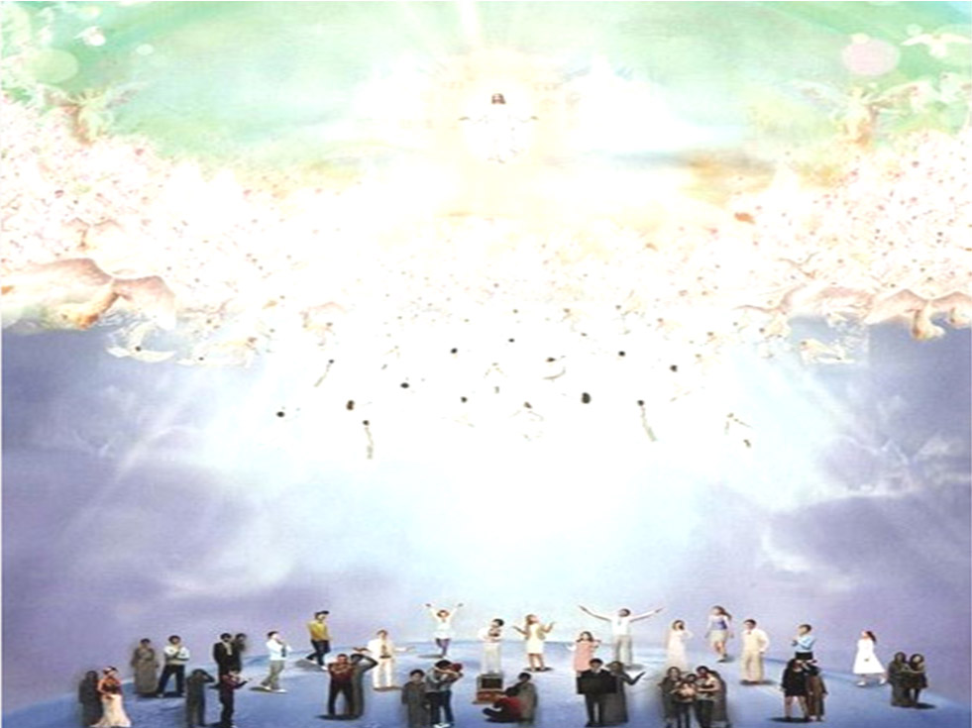
O come, let us sing to the Lord
1.O come, let us sing to the Lord, To Him our voices raise;
With joyful noise let us the Rock Of our salvation praise.
2. Let us before His presence come With praise, and thankful
voice; Let us sing psalms to Him with grace, And make a
joyful noise.
3. For God’s a great God, and great King; Above all gods He is.
The depths of earth are in His hands; The heights of hills are
His.
4.To Him the spacious sea belongs, For He the same did make;
The dry land also from His hands Its form at first did take. Amen

