Slide 1
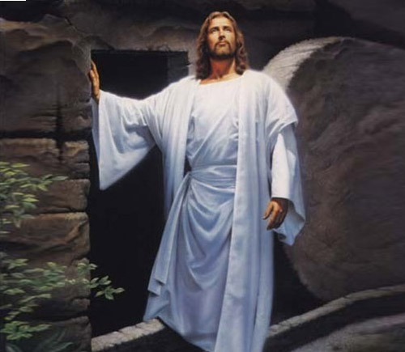
God the Omnipotent!
1. God the Omnipotent! King who ordainest thunder thy clarion, the lightning thy sword; show forth thy pity on high where thou reignest: give to us peace in our time, O Lord.
2. God the All-merciful! Earth hath forsaken thy ways all holy, and slighted thy word; bid not thy wrath in its terrors awaken: give to us peace in our time, O Lord.
3. God, the All-righteous One! Earth hath deified thee; yet to eternity standeth thy word, falsehood and wrong shall not tarry beside thee: give to us peace in our time, O Lord.
4. God the All-provident! earth by thy chastening yet shall to freedom and truth be restored; through the thick darkness thy kingdom is hastening: thou wilt give peace in our time, O Lord ,Amen

