Slide 1
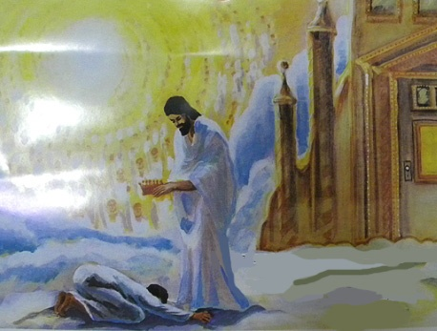
Crown Him With Many Crowns
1. Crown him with many crowns, the Lamb upon his throne, Hark! how the
heavenly anthem drowns all music but its own. Awake, my soul, and sing of
him who died for thee, and hail him as thy matchless King through all eternity.
2. Crown him the Lord of life, who triumphed o'er the grave, and rose victorious
in the strife for those he came to save. His glories now we sing, who died, and
rose on high, who died, eternal life to bring, and lives that death may die.
3. Crown Him the Lord of love Behold His hands and side, Rich wounds, yet visible
above, In beauty glorified: No angle in the sky Can fully bear the sight
But downward bends His burning eye At mysteries so bright.
4. Crown Him the Lord of years, the Potentate of time, Creator of the rolling
spheres, ineffably sublime. All hail, Redeemer, hail! For Thou has died for me;
Thy praise and glory shall not fail throughout eternity.

