Slide 1
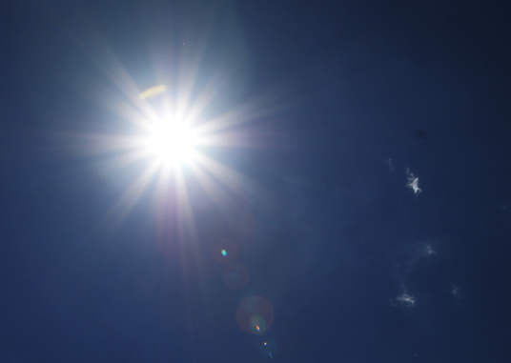
Higher Ground
1. I’m pressing on the upward way, New heights I’m gaining every day;
Still praying as I onward bound, Lord, plant my feet on higher ground
2. My heart has no desire to stay Where doubts arise and fears dismay;
Though some may dwell where these abound,
My prayer, my aim, is higher ground.
3. I want to scale the utmost height And catch a gleam of glory bright;
But still I’ll pray till rest I’ve found, Lord, lead me on to higher ground.
<Refrain>
Lord, lift me up, and let me stand By faith on Heaven’s table and;
A higher plane than I have found, Lord, plant my feet on higher ground.

